Slide 1

Enabling Addressable TV Advertising
Across Linear, VOD and Streaming
for Revenue Optimization

Slide 2

This Deck Will Cover:
The Canoe U.S. Ecosystem
Canoe Service Assurance SM
VOD
Linear
Streaming
Programmatic
Global Services

Slide 3
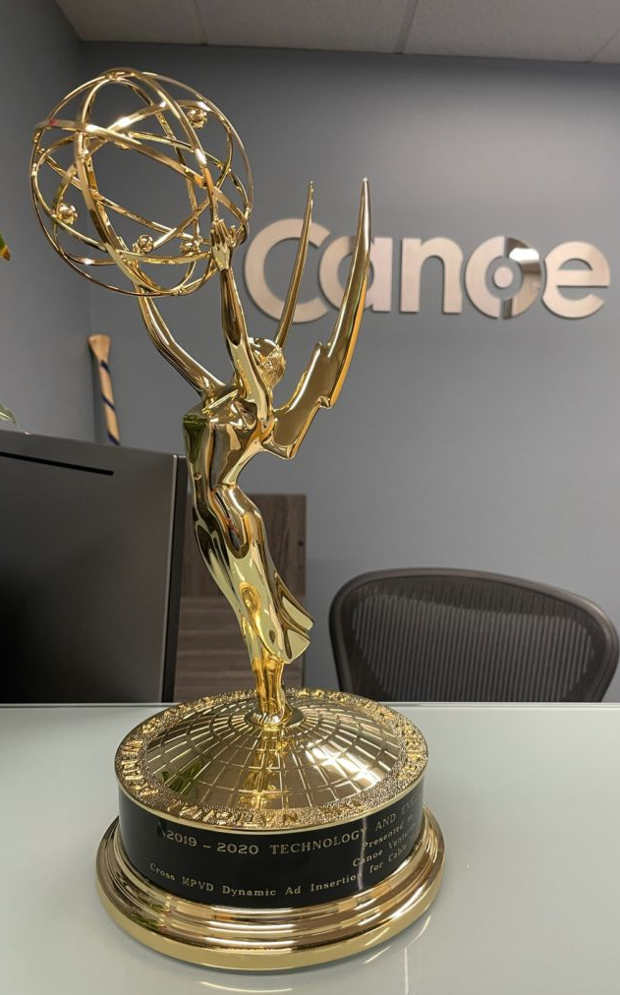

About Canoe
Integrates dynamic ad insertion into existing or new
video services
Enables Addressable TV advertising across Linear, VOD, and Streaming video platforms
Counts over 100 TV Networks, Streaming Services, and MVPDs as clients
Is owned by Charter, Comcast, and Cox
Is headquartered in Denver, Colorado, with offices in New York and Atlanta
Proprietary and Confidential | © 2022 Canoe Ventures, LLC | All Rights Reserved
3

Slide 4



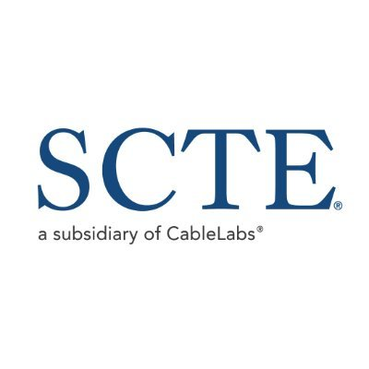



The Canoe U.S. Ecosystem
38+Million Households in every U.S. state and every DMA
Advertisers/DSPs
Ad Agencies/
DSPs
Global TV Networks/
SSPs
Ad Agencies/
DSPs
vMVPD
Stream Devices
Addressable Linear, VOD, Streaming
Consumers
Consumers
Consumers
Consumers
Consumers
Consumers
Proprietary and Confidential | © 2022 Canoe Ventures, LLC | All Rights Reserved
4

Slide 5
Canoe Service Assurance TM
A quality integrated ecosystem with persistent monitoring leads to maximum ad revenue
Integration - Assembles and maintains a stable, quality ecosystem
Monitoring – Allows Canoe to alert customers when an ad campaign may not play out properly
  Campaign traffic and scheduling issues
  Missing Break Points
  Missing Ad Maps
  Missing Entertainment and Ad Metadata
  Missing Entertainment and Ad Assets
  Invalid traffic
  Programmatic issues
  Audience Segment issues
  Impression under delivery issues
  Reporting and billing issues
  Attribution data issues
Resolution- drives all ecosystem partners to fix each issue as picked up by Monitoring
Analytics - provides insights for forecasting, planning, and ad revenue optimization
Proprietary and Confidential | © 2022 Canoe Ventures, LLC | All Rights Reserved
5

Slide 6

VOD Addressable Advertising
Where it all began for Canoe with our legacy Emmy Award® winning VOD dynamic ad serving (DAI) product and Canoe Service Assurance SM

Slide 7

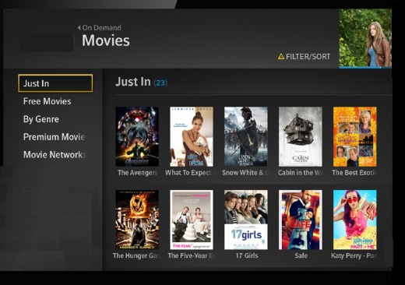
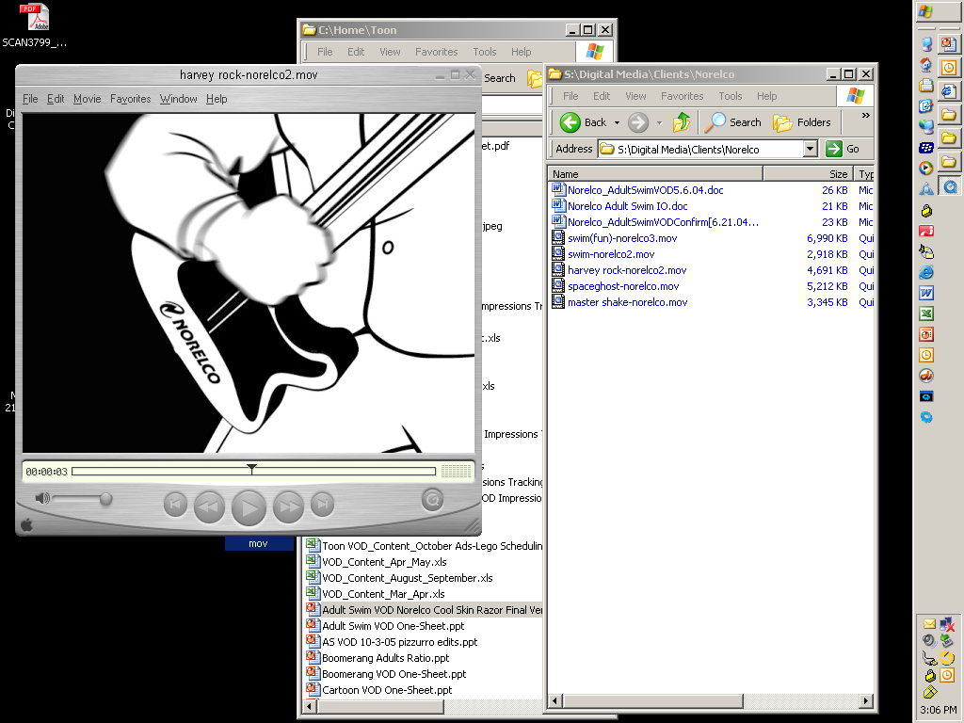
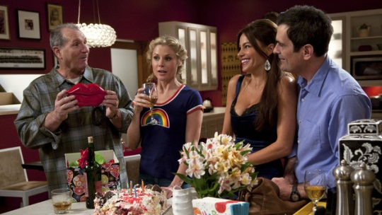
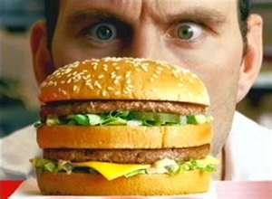
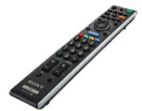
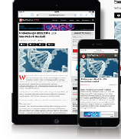
VOD Addressable Advertising
Programmers inserting addressable advertising into
their shows VOD devices & services
Consumer watches ads
inserted as ad breaks occur
before, during, and after program
Consumer picks TV program
from VOD service
Consumer watches
TV program
VOD Devices include: traditional QAM set-top-box, IP set-top-boxes, tablets, laptops, CTV, and mobile phones
Proprietary and Confidential | © 2022 Canoe Ventures, LLC | All Rights Reserved
7

Slide 8







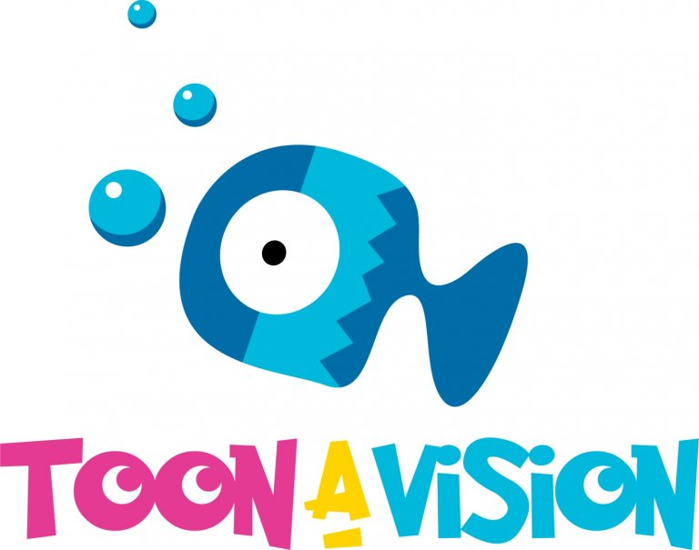







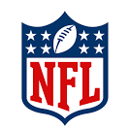
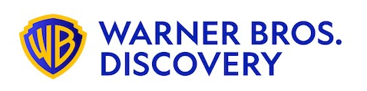
Current VOD Programmers Include:
AFRO TV
Bravo, E!, NBC, Oxygen, Syfy, Telemundo, USA, NBC Sports Net, NBC News, NBC Universo, MSNBC, CNBC, Golf Channel, Olympics, Universal Kids
A&E, Lifetime, History, LMN, FYI, Viceland
Starz, Starz Encore, MoviePlex
AMC, WE, Sundance, IFC, BBC America, AMC Plus
TV One
The CW
ToonAVision
Fox
Univision, Galavision, Unimas, Univision Deportes
Hallmark Channel
CBS, Nick Jr., Nickelodeon, BET, BET Her, Paramount, Pop, MTV, MTV 2, Showtime, VH1, Comedy Central, CMT, TV Land, Nick at Nite
Kabillion, Girls Rule
ABC, Disney Jr., Freeform, Disney Channel,
Disney XD, , FX, FXX, FXM, Nat Geo, Nat Geo Wild
EPIX
Discovery, American Heroes, Animal Planet, Destination America, Discovery Family, Discovery Life, ID, OWN, Science Channel, TLC, Motor Trend, Discovery en Espanol, Discovery Familia, Cooking, Magnolia, Food, HGTV, Travel, TBS, TNT, Adult Swim, CNN, Cartoon Network, HLN, Boomerang, truTV
NFL Network
8

Slide 9
Linear Addressable Advertising
Canoe Service Assurance SM brings all the experience of our legacy VOD business to Linear Addressable
ad campaigns

Slide 10
Linear Addressable Advertising
Canoe Service Assurance™ brings all the experience of our legacy VOD business to
Linear Addressable ad campaigns
This results in successful audience segment targeting, ad delivery, and revenue optimization
for our clients
In Q3, Canoe provided service for 32 different TV Networks across 96 addressable campaign lines
We enabled inventory from TV Networks’ national Linear and VOD inventory
Proprietary and Confidential | © 2022 Canoe Ventures, LLC | All Rights Reserved
10

Slide 11
Current Linear Programmers Include:
11

Slide 12
Streaming Addressable Advertising
Canoe Service Assurance SM brings all the benefits of our legacy VOD business to global streaming services including vMVPD, TVE, CTV, OTT,
and FAST channels

Slide 13

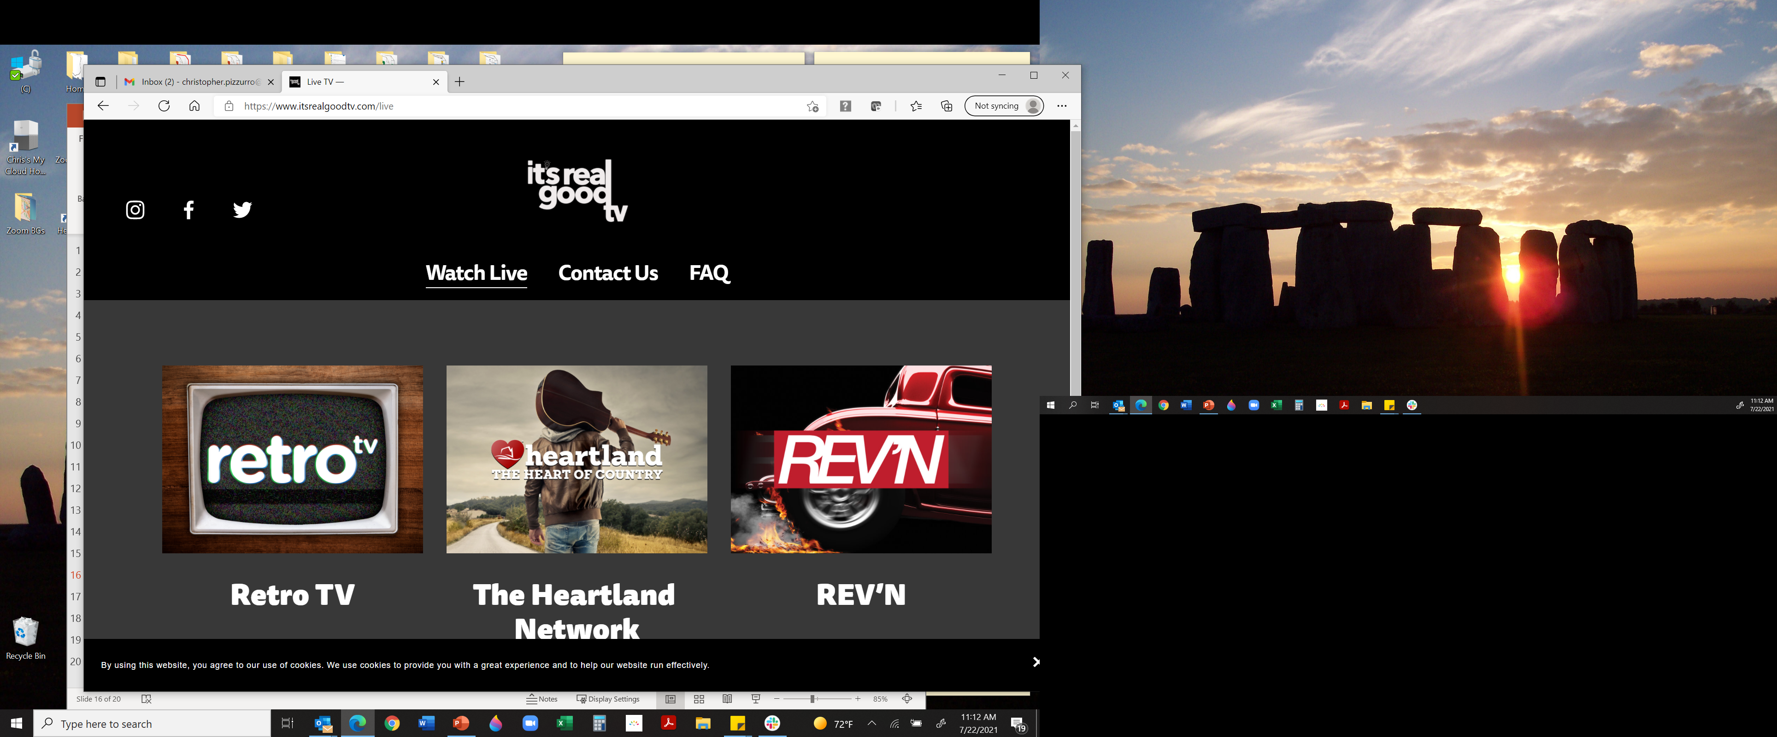





Current Streaming Programmers Include:
13

Slide 14
Programmatic
Demand Side Platforms (DSPs) via Supply Side Platforms (SSPs)
inserting ads into Programmers shows on VOD

Slide 15



Programmatic
Canoe has enabled 3 Supply Side Platforms (SSPs) for access to Programmer's inventory
The SSPs now connect to 17 unique Demand Side Platforms (DSPs)
In Q3 2021, Canoe provided service for 30 different TV Networks across 73 programmatic campaign lines, up 33% from Q2
This capability continues to expand to more Programmers and more DSPs
Proprietary and Confidential | © 2022 Canoe Ventures, LLC | All Rights Reserved
15

Slide 16
Global Services
Canoe services are available to Programmers and MVPDs in Canada, Latin America, and Europe

Slide 17

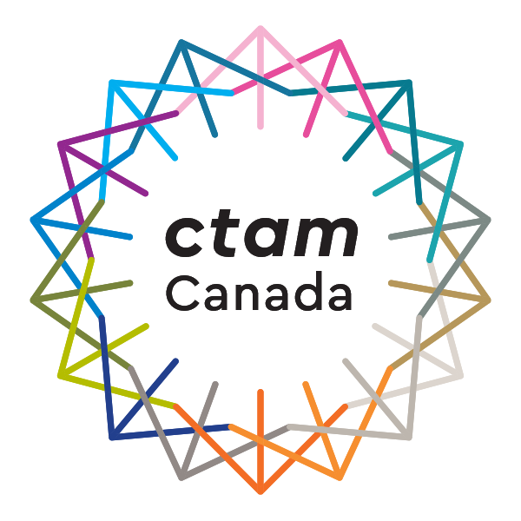


Servicing Global Programmers & MVPDs
Services current Programmers, Streaming Networks, and MVPDs
Working with industry trade groups including ThinkTV, CTAM Canada, and LAMAC, Canoe takes the time to incorporate local needs into its solution so that each market is successful on its own terms
Proprietary and Confidential | © 2022 Canoe Ventures, LLC | All Rights Reserved
17

Slide 18
Thank You

